Slide 1
InstaShop – An Ecommerce Platform With Optimized Delivery and Personalized Recommendations
Guided by: Prepared by:
Dr. Jane Liu Madhur Chaurasia
Dr. Timothy Roden Poonam Sangle
Dr. Jing Zhang Anit Jyotishi

Slide 2
Introduction
Shopping module
Recommendation system using Apriori algorithm
Admin(seller) login
Delivery-person Login
Optimized delivery (Travelling salesman problem) using Google Geocoding API, haversine’s formula and Hill Climbing Algorithm.

Slide 3
Motivation
Generally, academic projects for ecommerce focus only on user perspective.
An ecommerce website which increases efficiency for the delivery person.
A ecommerce website which maximizes the seller profit by showing accurate recommendations.
An ecommerce website with material design and rich user experience.

Slide 4
Why MEAN( Mongo DB, ExpressJS, AngularJS, NodeJS)??????
Flexibility – Same data model across Model, View and Controller – JavaScript Objects
Use of JavaScript all across the stack means that no resources are needed for other technologies.
NodeJS is highly concurrent as compared to PHP.
MongoDB is schema less database .It is highly scalable.

Slide 5
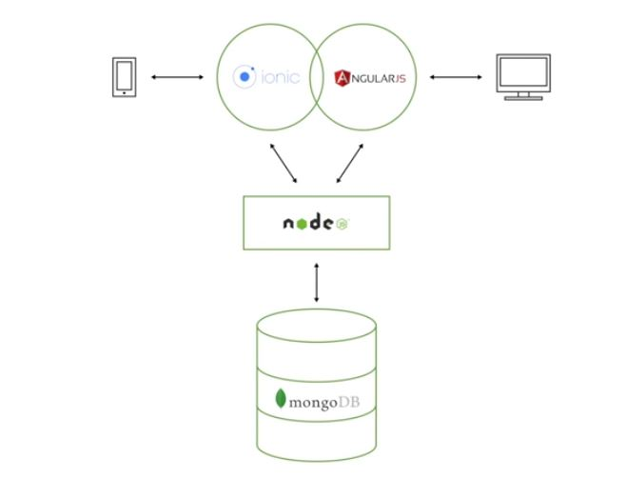
Why MEAN( Mongo DB, ExpressJS, AngularJS, NodeJS)???? Contd.
Extensibility into a mobile app:

Slide 6
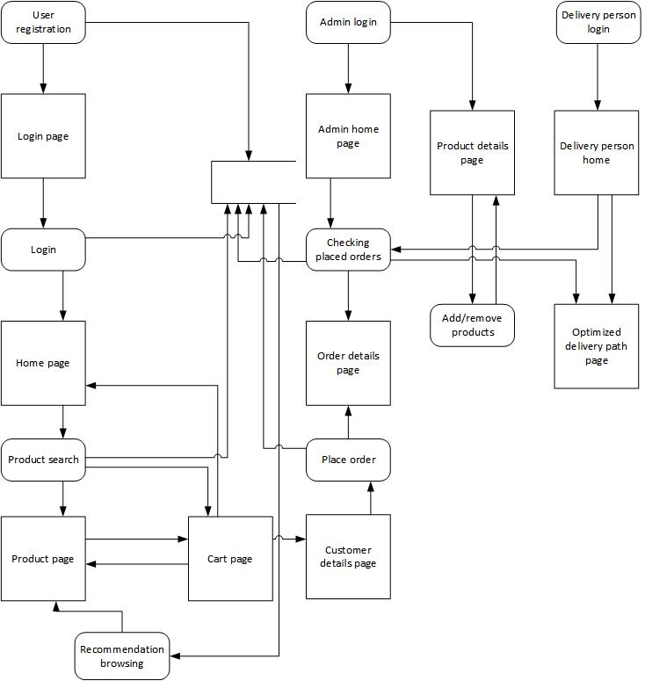
Application Flowchart

Slide 7
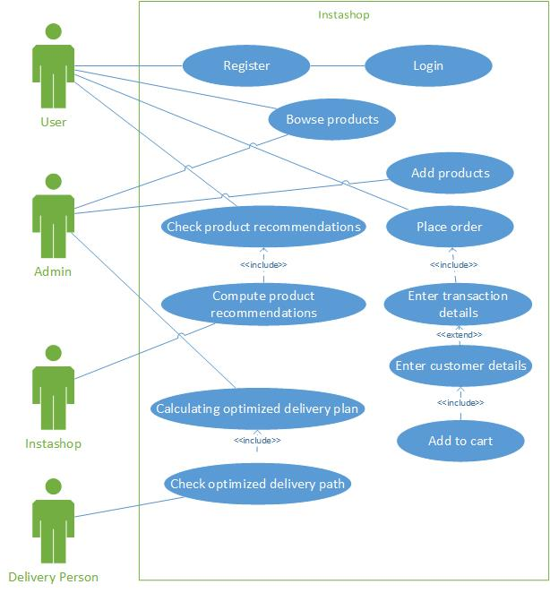
Use Case Diagram

Slide 8
Implementation Status
Product browsing
Product recommendations
Add to cart
Checkout after entering address
Administrator login and inventory management
Delivery person login and optimized delivery

Slide 9
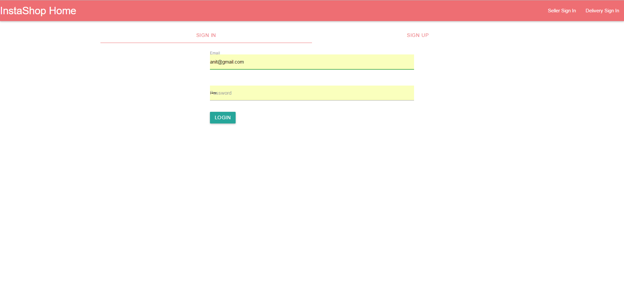
User Interface – InstaShop Home

Slide 10
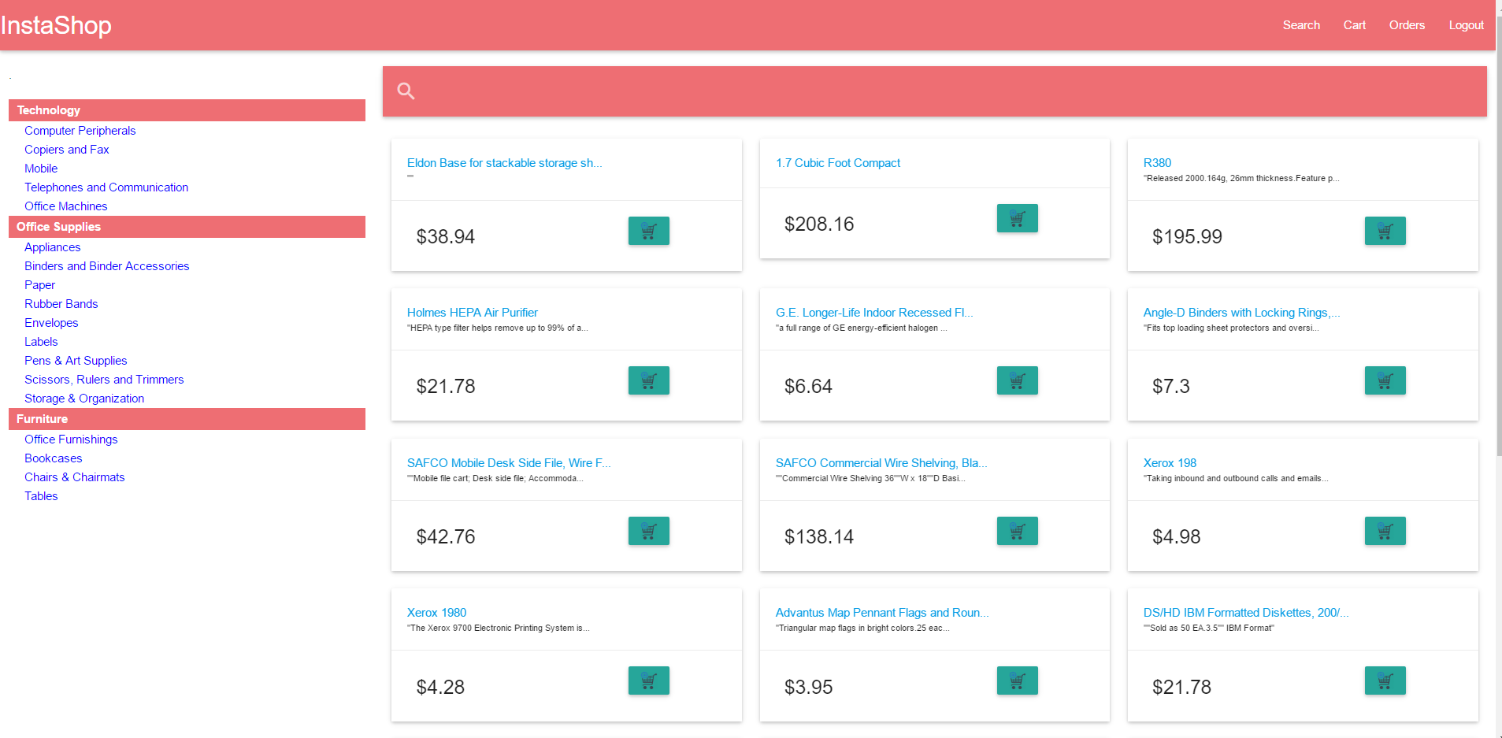
User Interface - Customer Login

Slide 11
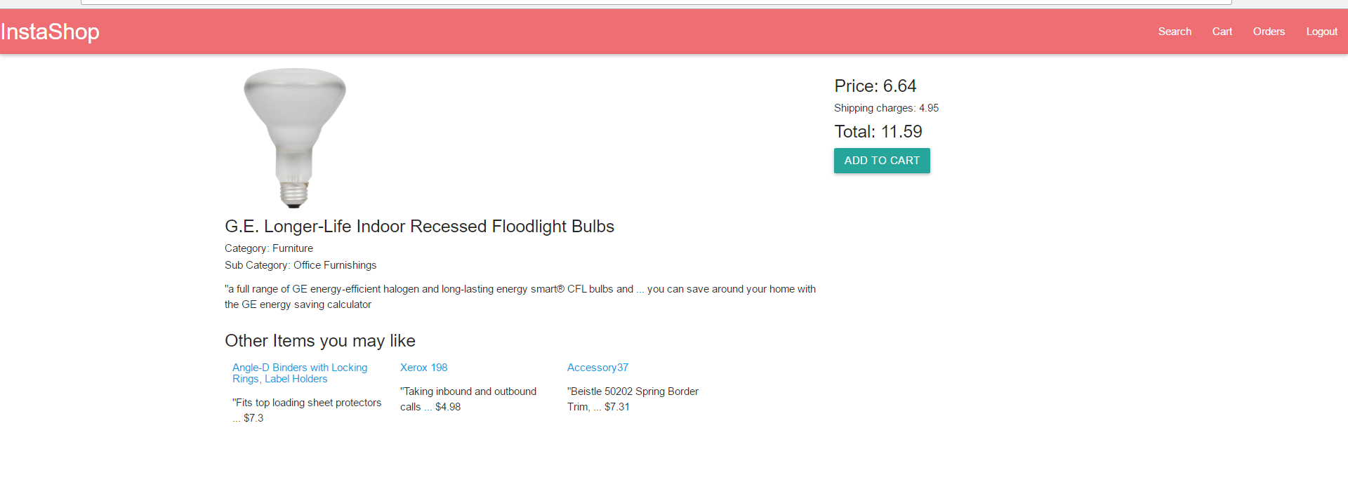
User Interface – Product details with recommendations

Slide 12
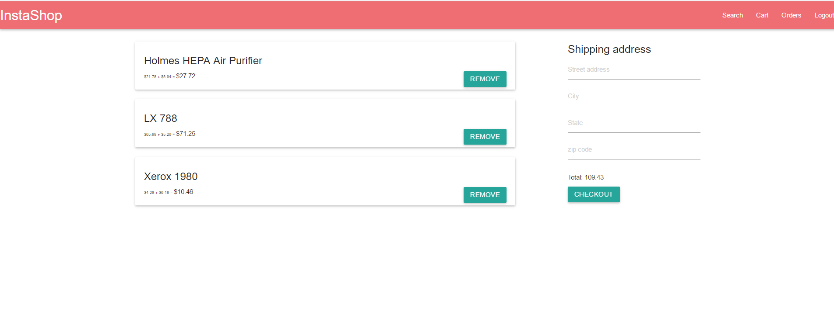
User Interface – Shopping Cart

Slide 13
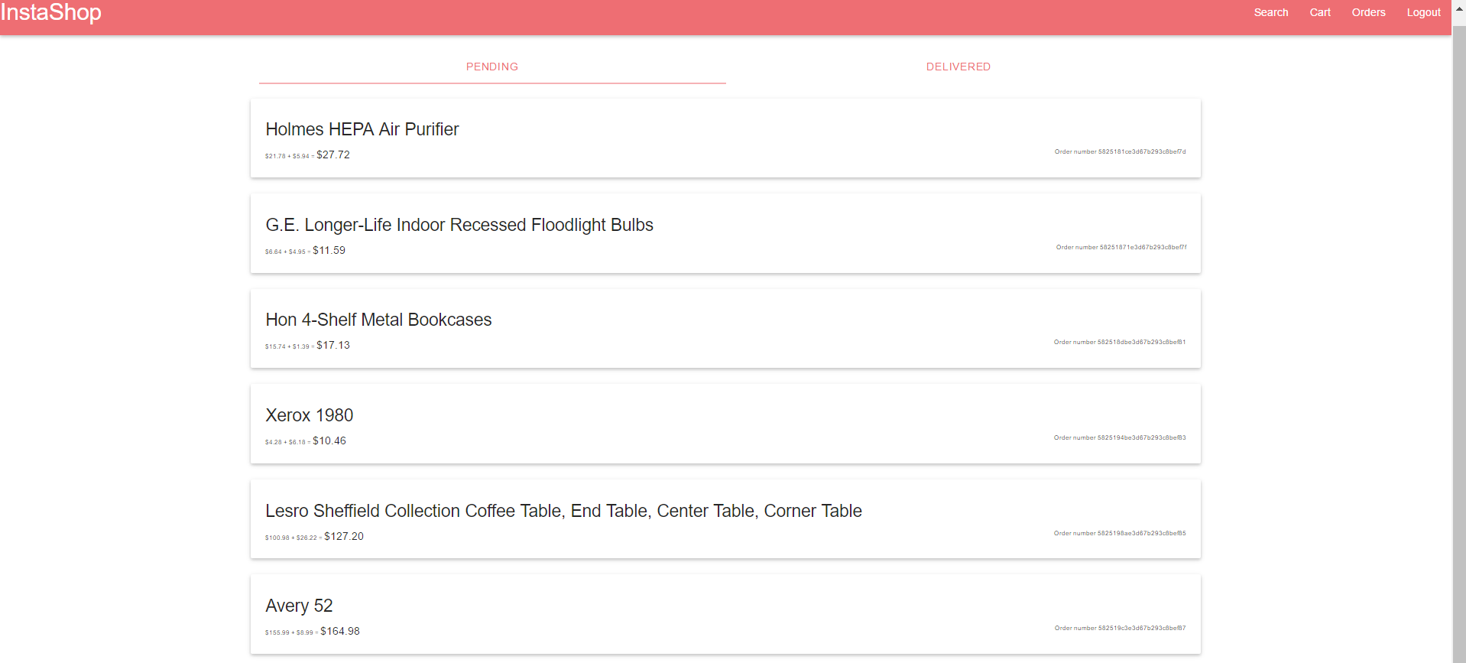
User Interface – Checking Order Status

Slide 14
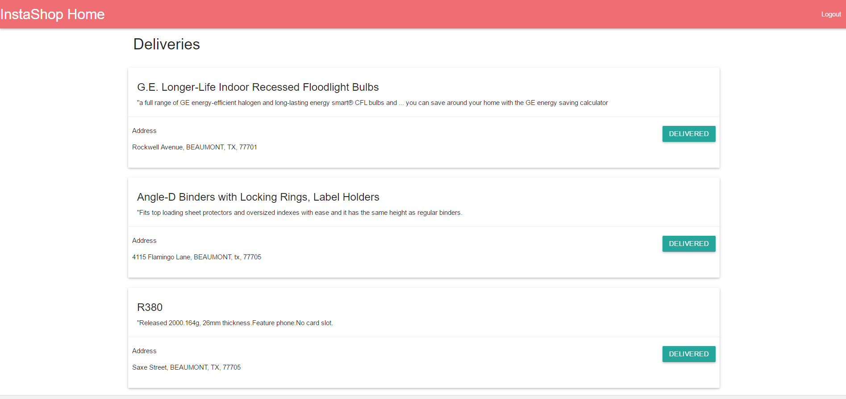
User Interface -Delivery Person Login

Slide 15
Apriori Algorithm for Product Recommendations
Runs as a batch job once a day.
Recommendation system is based on prior purchases.
Better strategy than recommendation system based on customer feedback as not all customers review the products.
Implemented through Apriori Algorithm

Slide 16
Apriori Algorithm for Product Recommendations - Contd.
Apriori algorithm involves using frequent itemsets to generate association rules.
Operates on databases containing transactions(Order details in our case)
Each transaction is seen as a set of items (an itemset)

Slide 17
Apriori Algorithm for Product Recommendations - Contd.
Uses minimum threshold to identify frequent items sets.
Our algorithm identifies itemsets with frequency of 10 or more as being frequent.

Slide 18
Apriori Algorithm for Product Recommendations - Contd.
We are recommending two products with each product.
Simple strategy to handle conflicts in case we have more than two items frequenting with one item.
If {A,B,C} and {A,D,E} are both equally frequent then we add all item and remove in FCFS order.

Slide 19
Performance Testing – Personalized Recommendations Using Apriori Algorithm
Preprocessing - Grouping all the data orders by customers.
Out of 796 Customers in total, 600’s data would be used to train our algorithm(75%).
Rest 196 would be used as test set.(25%)

Slide 20
Performance Testing – Personalized Recommendations Using Apriori Algorithm - Contd.
Final result :
Maximum Accuracy = (No. of items purchased out of recommended / Total no of recommended items)*100 = 24%.

Slide 21
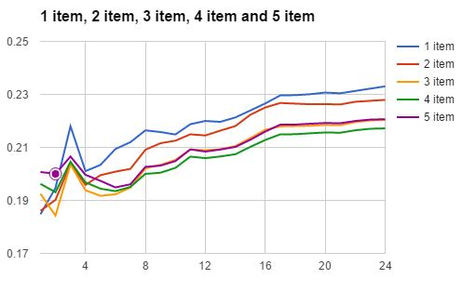
Performance Testing – Personalized Recommendations Using Apriori Algorithm - Contd.

Slide 22
Hill Climbing Algorithm for Travelling Salesman Problem
Hill Climbing Algorithm has been used to optimize delivery (Travelling Salesman Problem)
Greedy approach which starts from the starting address, covers the closest address among all remaining addresses. This continues till all the addresses have been covered.

Slide 23
Hill Climbing Algorithm for Travelling Salesman Problem (Contd.)
Google Maps Geocoding API to convert destination addresses to geographic co-ordinates.
Haversine’s formula to calculate distance between two geographic co-ordinates on a spherical surface.

Slide 24
Hill Climbing Algorithm for Travelling Salesman Problem (Contd.)
Steps:
Calculate geo coordinates for all the addresses.
Calculate all the addresses from the starting point.Mark the closest delivery address as the first destination.
Pick the address closest to the first destination and mark it as second destination.
Continue till all addresses have been covered.

Slide 25
Performance Testing – Optimized Delivery
Tested by choosing familiar area near campus with limited delivery addresses.
Compared optimized path suggested by us to the path on google maps.
Google Maps API uses road distance, we used circle distance for points on through Haversine formula.
Although no way to compare this mathematically, the results were satisfactory when analyzed on the map of the Area.

Slide 26
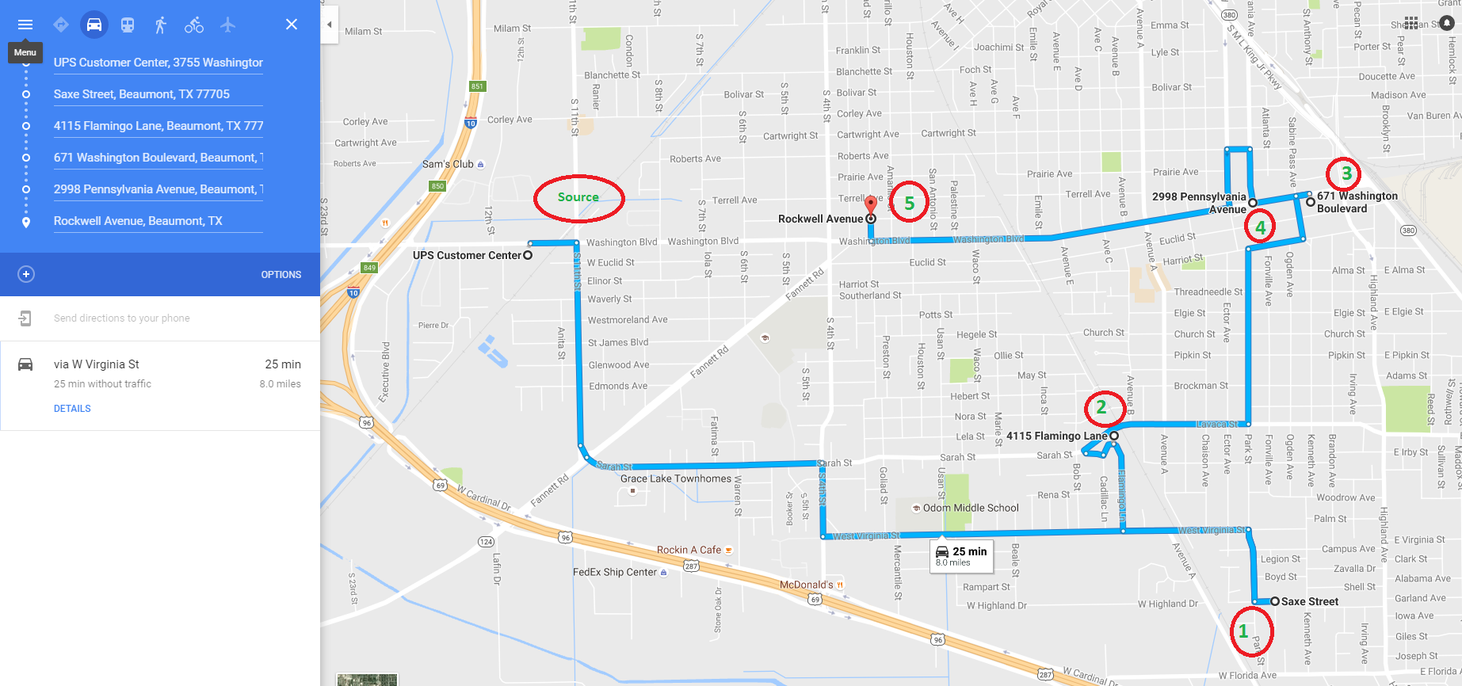
Performance Testing – Optimized Delivery(Contd.): Before batch job

Slide 27
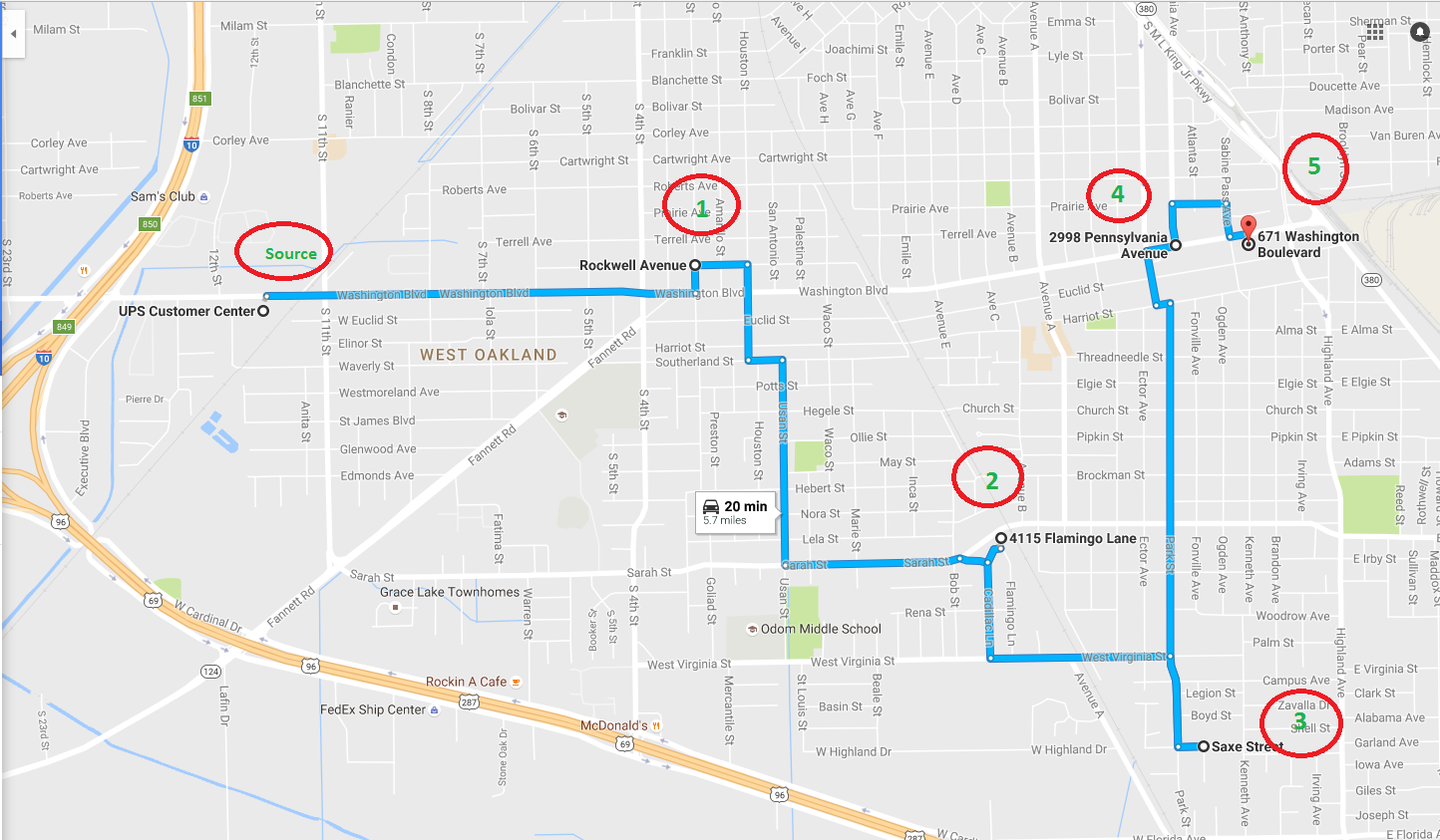
Performance Testing – Optimized Delivery(Contd.): After batch job

Slide 28
Reflection - Challenges
Biggest challenge :
Not Apriori
Not Hill Climbing Algorithm
Not Google Geocoding API
Biggest challenge was learning MEAN (Mongo, Express, Angular, Node) Stack– Technology has just as big an impact on software as programming practices and algorithms.

Slide 29
Reflection - Takeaways
It is the technology which determines the scalability ,user experience and the maintenance cost.
Experiencing the immense power of JavaScript and its frameworks
Getting started with MEAN Stack which is the most in demand technology stack in the industry today.
Project planning.
Documentation
Teamwork

Slide 30
Future Scope
At present, personalized recommendation is based on Apriori Algorithm to find frequent item-sets. In future, this system can be on percentage-basis where 70% would be on frequent item sets and 30% on collaborative filtering where predictions are based on interests of a user by collecting preferences or taste information from many users.

Slide 31
Deliverables
Deliverables
Readme.txt – Execution and setup instructions
Progress Report
Project Report
Demonstration Video

Slide 32
References
http://www.infoworld.com/article/2937159/application-development/mean-vs-lamp-your-next-programming-project.html
https://en.wikipedia.org/wiki/Hill_climbing
https://en.wikipedia.org/wiki/Apriori_algorithm
https://www.mongodb.com/compare/mongodb-mysql

Slide 33
Demonstration

Slide 34

Questions???

